Slide 1

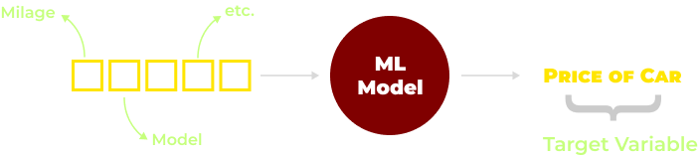
Cars 24 Problem Overview
Data scientist at Cars 24
Sells pre-owned cars
To automate pricing the old car
Given car features
Predictors / Features
( Make, Model Mileage , Odometer, Service History etc. )

Slide 2
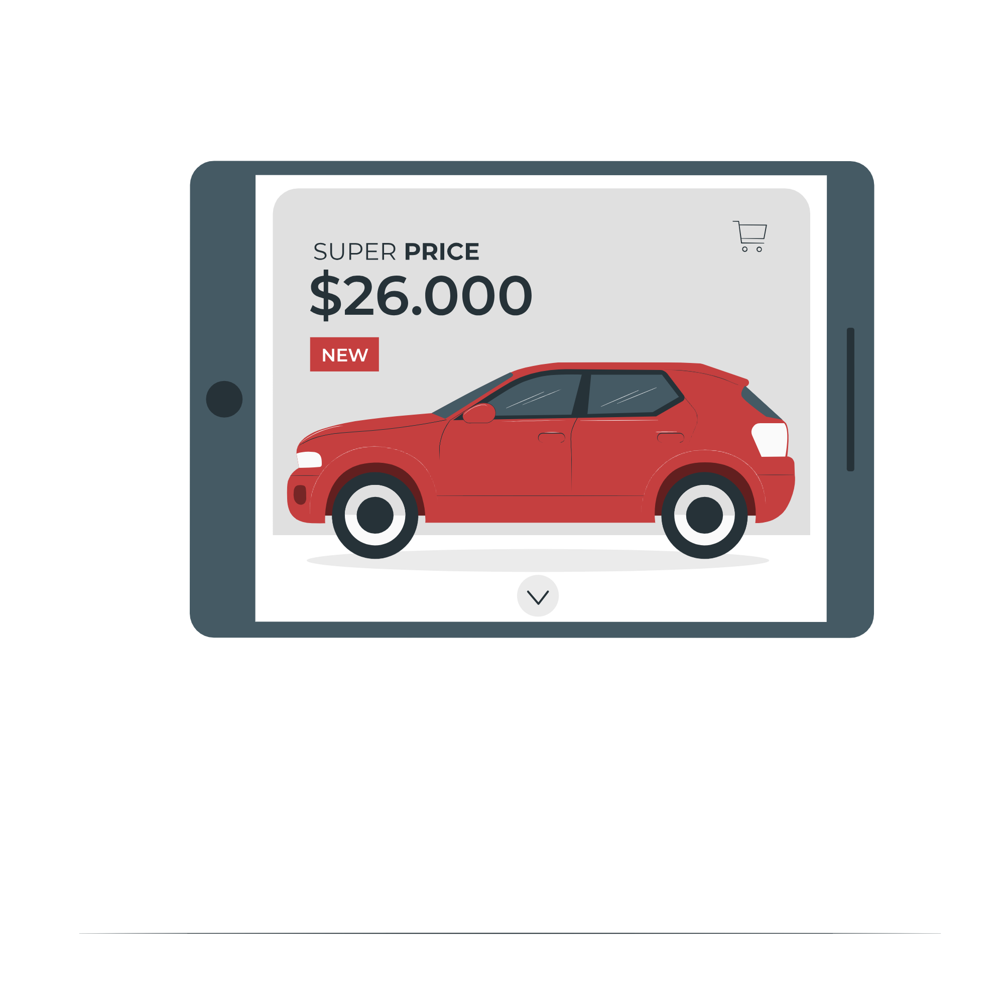
Train an ML Mode such that
We have target in training data
SUPERVISED
Target variable is continuous
REGRESSION

Slide 3
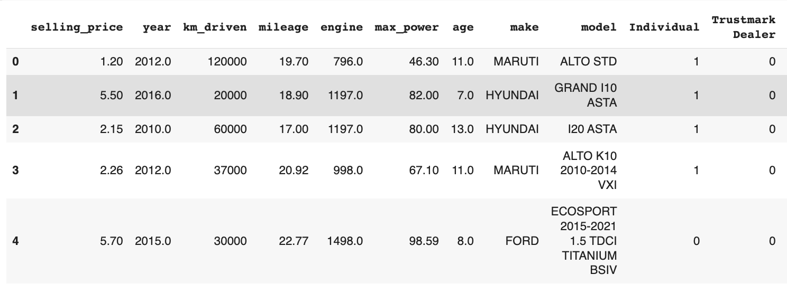
Look at the Data . .
Noticed any issue with the data ?
Make and model column have lots of categories
All columns are in different ranges e.g. age and km_driven

Slide 4
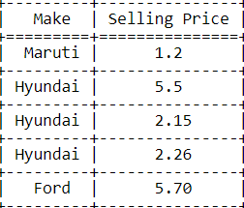
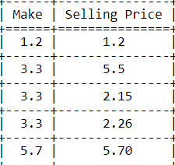
Revision - Target Variable Encoding
Make: 41 categories
Using One Hot Encoding will result in a lot of dimensions -> curse of dimensionality
Hence, Target Encoding
Target Encoding
Target encoding replaces the categories with a number representing the average target value associated with each category.
Maruti - 1.2
Hyundai - 3.3
Ford - 5.70
Replace
M E A N

Slide 5

Line of Code
df['make'] = df.groupby('make')['selling_price'].transform('mean')
df['model'] = df.groupby('model')['selling_price'].transform('mean')

Slide 6
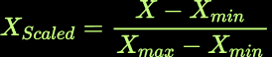

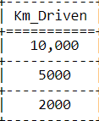
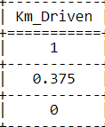
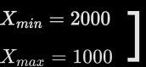
Revision - Scaling the Data
Min - Max Scaler
Min
Max
Scaling
Note:
Since all the features are in different ranges, we need to scale the data.
Later we will see why is scaling important

Slide 7
Line of Code
from sklearn.preprocessing import MinMaxScaler
scaler = MinMaxScaler()
df = pd.DataFrame(scaler.fit_transform(df), columns=df.columns)

Slide 8
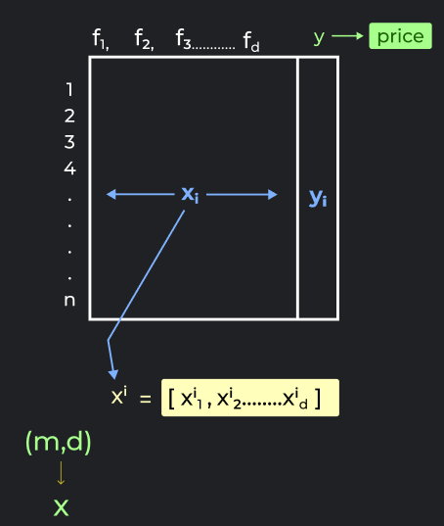
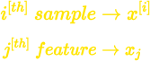
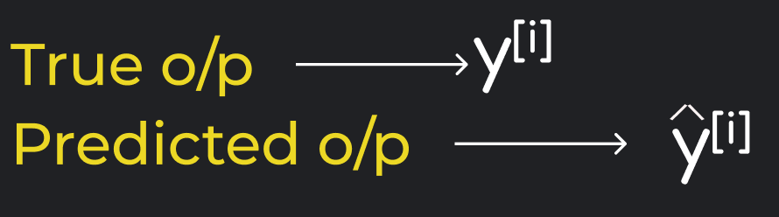
Data Notation
m → no. of samples
d → no. of features
n → no. of classes
Don't get intimidated by the terms,
we will go through all of them as we proceed with this module.

Slide 9

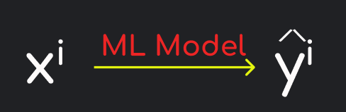

Goal of generalization in ML
Assume you had m samples
Using Historical data we train ML Model
Predicted Value
Original Price / Ground Truth
Ideally,
If for m samples at an average
GOOD TRAINING

Slide 10
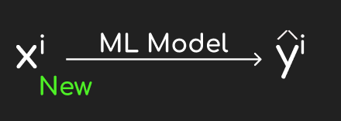

But,
Goal: Predict well on New sample.
Problem??
How do we know if our model is good in predicting for NEW sample ?
UNKNOWN

Slide 11


Solution:
Because we don’t know the ground truth (y) for New Sample
DO NOT use whole data for TRAINING
Typically,
Use this for training the data
80%
Use this as a proxy for unseen data
20%
‘y’ known
Check if:
For evaluating model performance

Slide 12

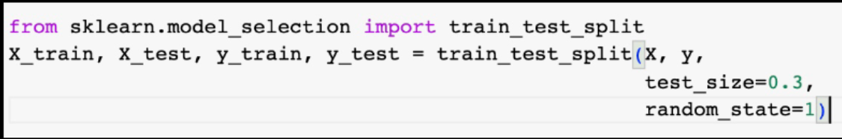
Phases for Model Development
Training - use train split
To check if model is learning
Testing- use test split
To check if model is generalising

Slide 13
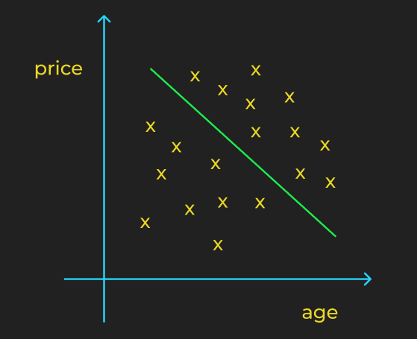

Linear Regression Intuition - Single variable
Let’s take one feature : Age
Suppose we want to predict price of car from it's age
How do you think price of car change with it's increasing age ?
-> Decrease with age

Slide 14
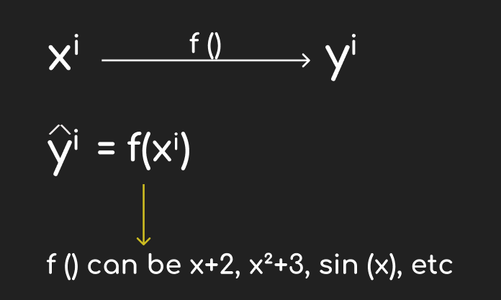
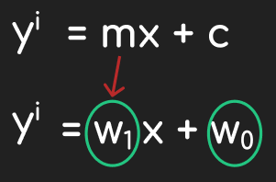
y is a function of x
1 predictor LR = Straight line
Geometrically,
Linear Regression is trying to find a line such that most of the points are close to the line
Learning??
Estimating best values of <w> vector

Slide 15
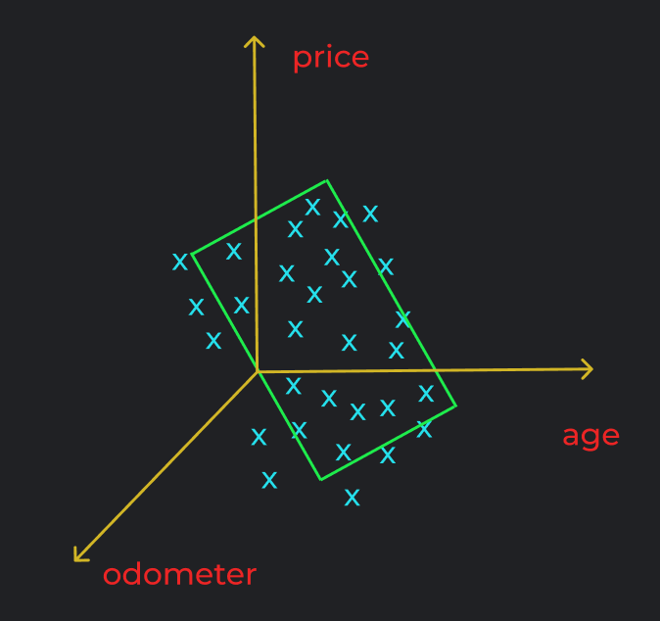

Now, what if we take 2 predictors? - age , odometer
Weightage given to x1
Bias ( to be discussed later)
Weightage given to x2
What would be the linear function for this case, in 3D??
A Plane

Slide 16

Univariate linear regression – 1 feature
Straight line 2D
Bivariate linear regression —- 2 features
Plane 3D
Multivariate linear regression — d features
d+1 hyperplane
Learning in Linear Regression
Estimating best values of < w0, w1, w2, ………wd > Which means to find the weights of best fitting line

Slide 17
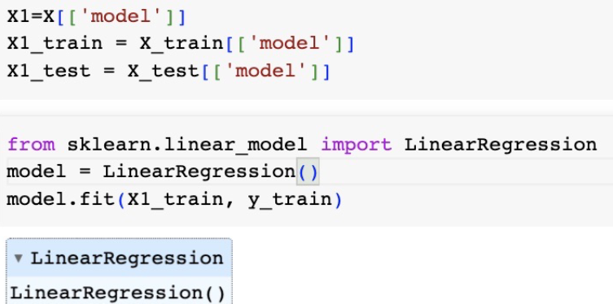
Linear Regression using Sklearn
Univariate
Fitting the model on 1 predictor

Slide 18
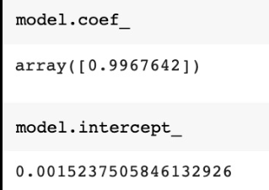

Univariate
Model Weight and Bias

Slide 19
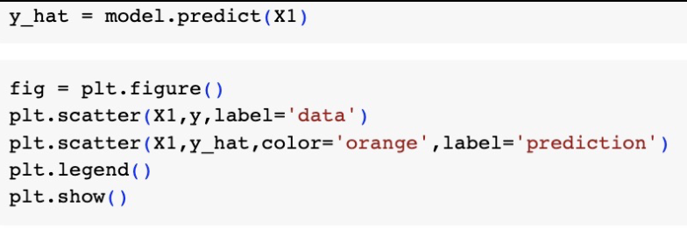
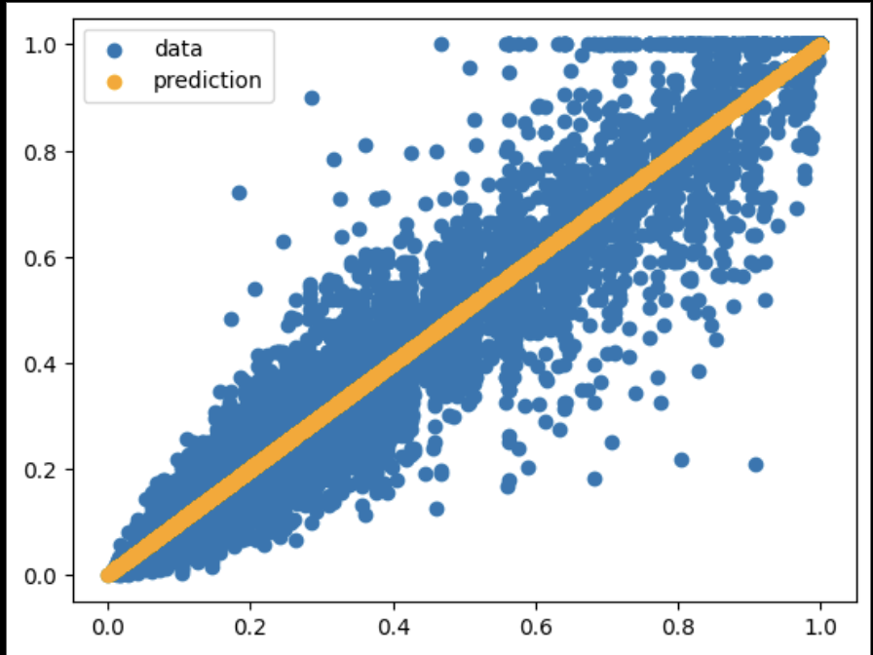
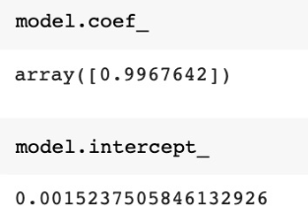
Linear Regression using Sklearn
Univariate
Plotting the predicted values
Model : Wt. and Bias

Slide 20
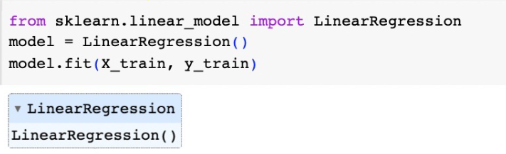
Linear Regression using Sklearn
Multivariate
Training on d features

Slide 21
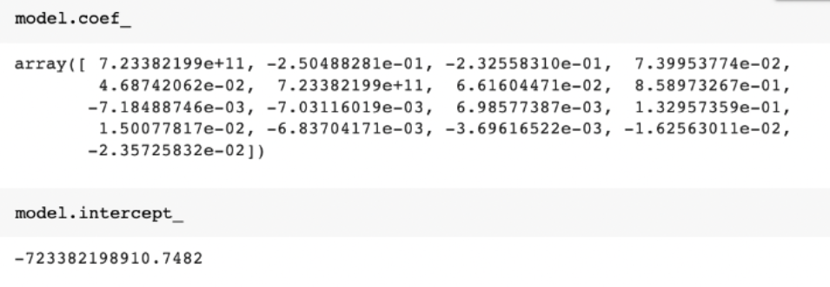
Linear Regression using Sklearn
Multivariate
All features weight and bias

Slide 22
Is my model good?
Is there any way to measure the performance of our model?
Let's break down the problem.
Goal -> To minimize the distance between the predicted point and the actual point.
The closer the predicted value to the actual value, the better is the model.

Slide 23
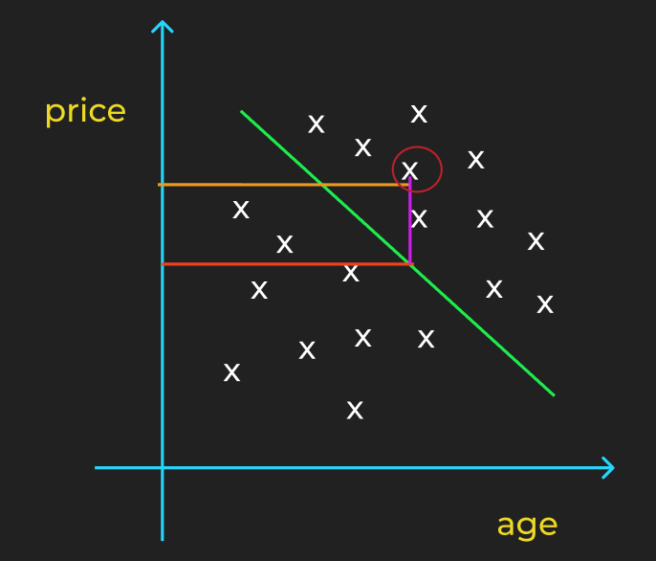
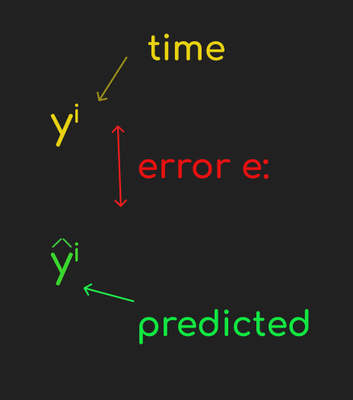
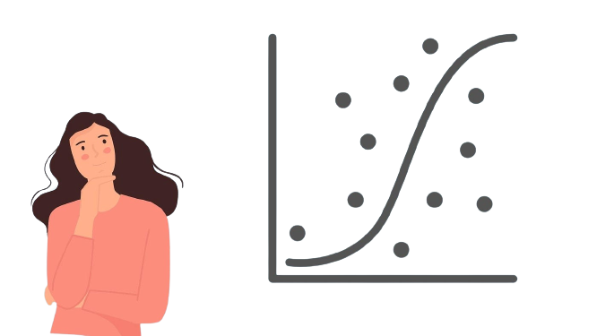

How can we evaluate our model?
Let’s take our price vs age model:
minimize

Slide 24
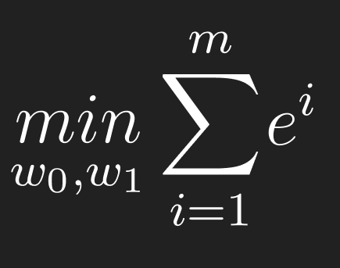



Aim?
Find Better Model with Lesser Error
Best
Min
Can we use
as a metric?
NO! WHY??

Slide 25
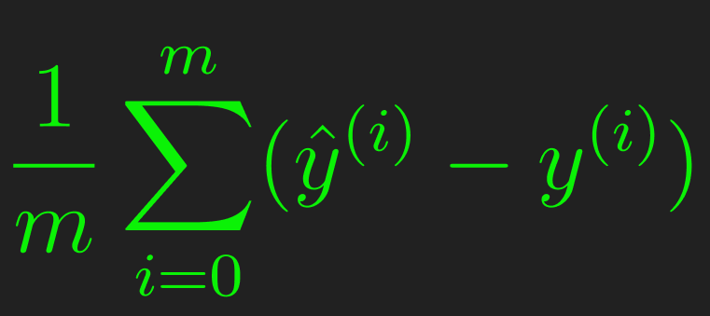
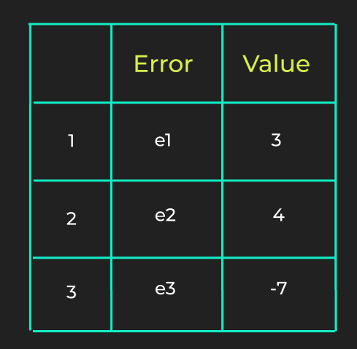
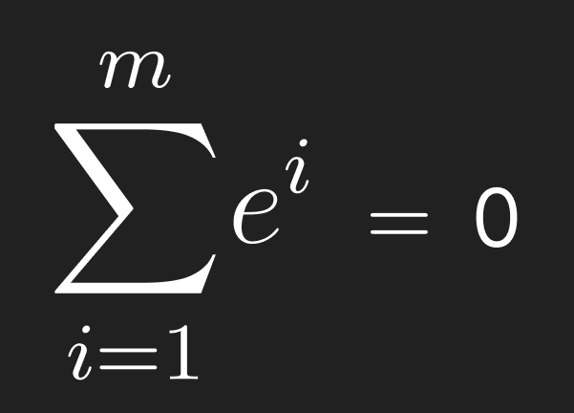

So, for multiple points..
It will be the sum of the error divided by 𝑚 :
Can we use sum of errors as a metric??
NO
Perfect model??
WRONG!!

Slide 26
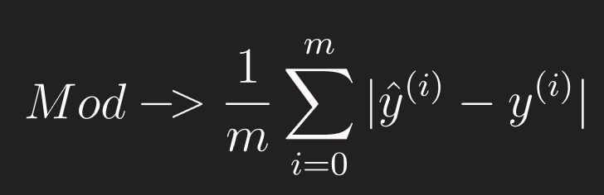
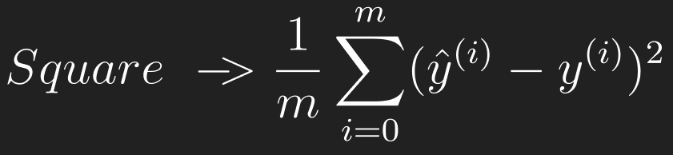
SOLUTION ??
ABSOLUTE
MAE
SQUARED
MSE
LOW ERROR = BETTER MODEL

Slide 27
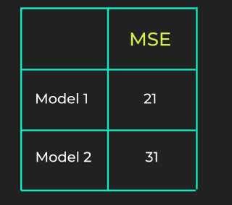
Best among two models ?
Issue with MSE or MAE,
-> it gives a value between 0 to ∞
-> value depends on the range of values predicted.
Can be in 100s, 1000s, or 10000s
How small of an MSE is good enough?
Is 1 a good mse score, or 10, or 100?
This makes a problem since there is no common scale/range to measure the performance.
M1 IS BETTER!!

Slide 28
What if it is a single model?
MSE/MAE
Compare n models
1 Model
How to evaluate?
Here we can use a metric called
"R2 Score", or the "coefficient of
determination".
It tells us how well a regression
model fits the data.

Slide 29

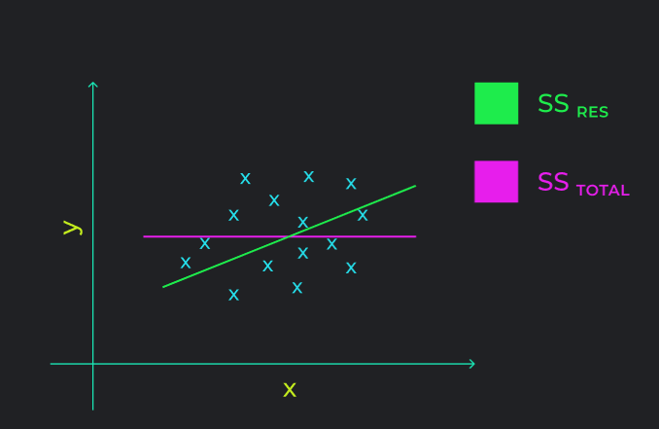
Let’s plot the pt.s between x and y for model M1
What will be worst model that we can built?
Model we’ve built
Mean model
Mean model returns mean of yi's as predicted value every time.
Baseline model
(Mean model)
SS_residual : sum of squared errors for the model that we built
SS_total : sum of squared errors if the model was mean model.

Slide 30
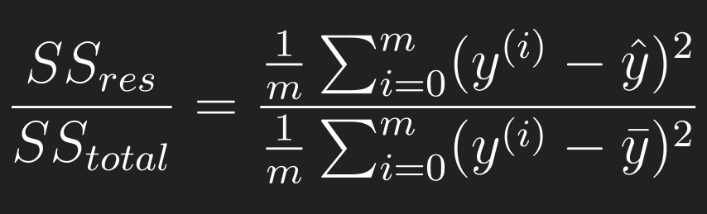
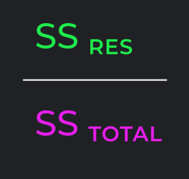
Predicted
Mean
0
1
Generally
Bad
Good
SMALL
GOOD MODEL
LARGE
BAD MODEL

Slide 31

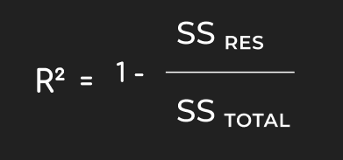
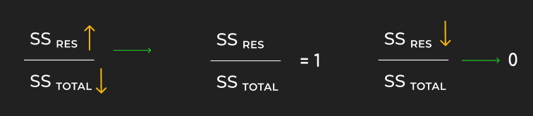
- ∞
1
0
∞
Worse than baseline
Equally bad as baseline
Much better than baseline

Slide 32
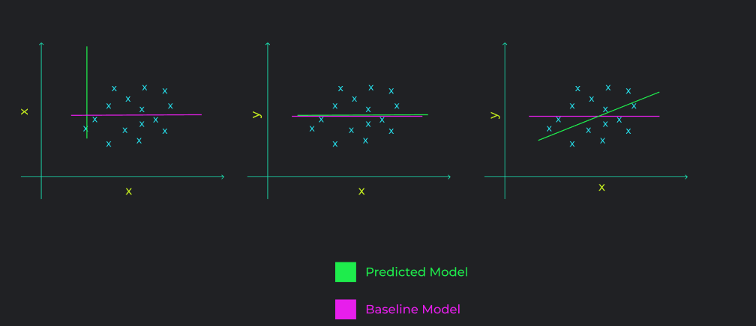
Extremely Bad Model
Mean Model
Great Model
Range for r2 score =
[ - ∞ , 1 ]

Slide 33
Model Interpretability
We know,
Suppose
How to understand these weight values?

Slide 34
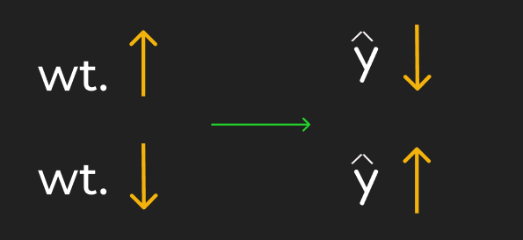

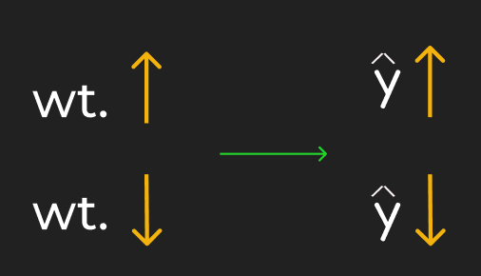

Cases as per sign
-ve weight of feature
2. +ve weight of feature
3. Wt = 0
or
No effect

Slide 35


Cases as per magnitude
Let’s take e.g of age & odometer
Age wt. = -10000
Odometer wt. = 10
AGE
AGE + 1
ODOMETER
OD + 1

Slide 36
LARGER THE ABSOLUTE VALUE, MORE IMPORTANT THE FEATURE
So, is age >>>>> odometer imp??
Can’t be true!!
SCALE IS DIFFERENT, UNIT IS DIFFERENT
WHY??

Slide 37
AGE - [ 1, 15 ] Years
ODO - [ 5000, 250000] Kms
Solution
Feature Scaling

Slide 38
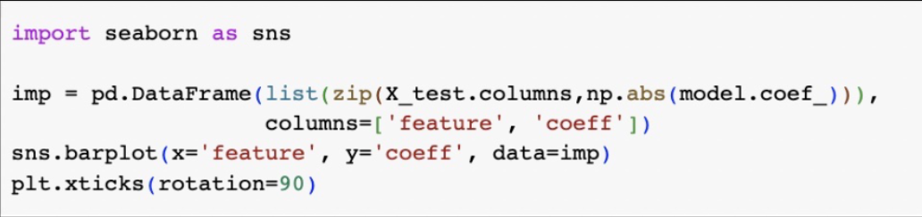
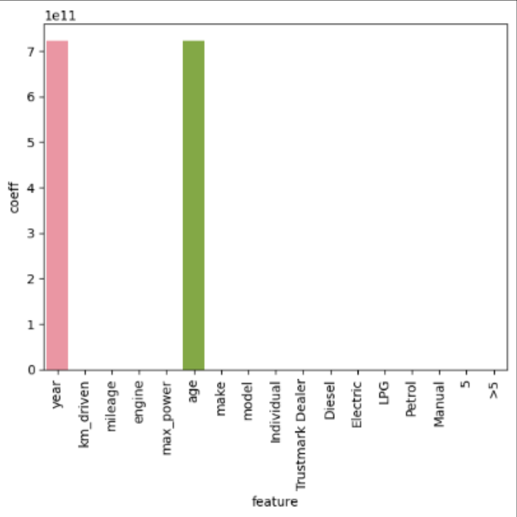
Bar Plots of Feature Importances
“Year” & “age” are most important

Slide 39
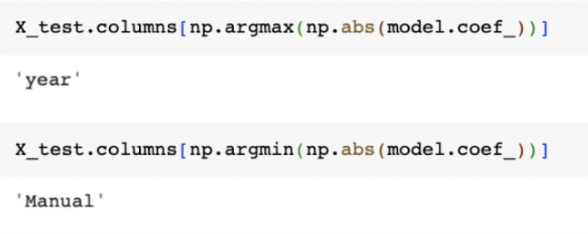
Which feature is most / least important??
“Year” —- Most important
“Manual” —-- Least important

